Slide 1
Introduction to Statistics for Ecology and Evolutionary Biology MCMC, Link Functions, and Generalized Linear Models Week 13 6 December 2021

Slide 2
Markov Chain Monte Carlo (MCMC)
Monte Carlo methods are computational algorithms based on repeated random sampling
Markov chains are stochastic models in which the future state can be predicted solely from the current state
Markov chain Monte Carlo methods can allow us to generate samples from a probability distribution
Which probability distribution? The posterior!
Notes:
So, critically, we are moving from describing the posterior distribution by using an approximation to sampling directly from it
The Stan programming language is based on the Hamiltonian Monte Carlo, a specific MCMC algorithm

Slide 3
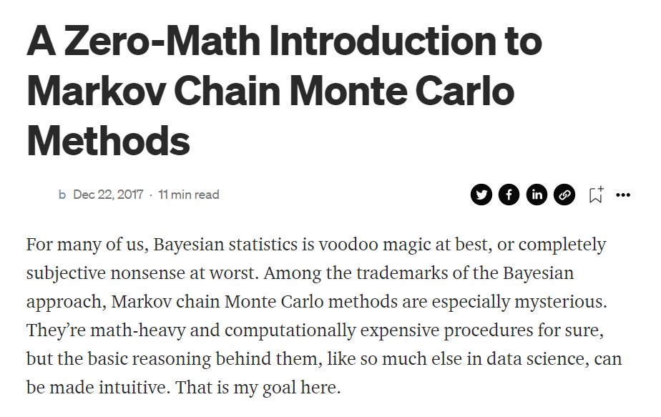
Good read…
https://towardsdatascience.com/a-zero-math-introduction-to-markov-chain-monte-carlo-methods-dcba889e0c50

Slide 4
Validating MCMC Chains
Plot chain trace plots to check for stationarity and mixing
Examine fit statistics like Rhat
Values for each parameter should converge towards 1.00
In general, running multiple chains can help assure us that chains are converging on the target distribution
MCMC methods are guaranteed to converge towards the target distribution in the infinite. But we’re not running our chains for infinite time…
Notes:
“Stationarity refers to the path staying within the region of high probability of the posterior distribution.”
“A well-mixing chain means that each successive sample within each parameter is not highly correlated with the sample before it.”

Slide 5

Lecture code, part 1

Slide 6
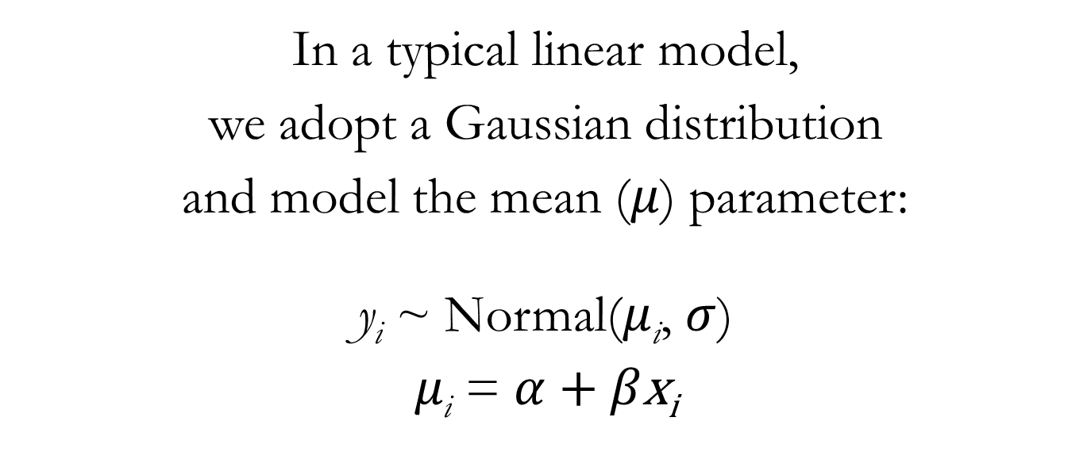
From Linear Models to Generalized Linear Models (GLMs)
In a typical linear model,
we adopt a Gaussian distribution
and model the mean ($μ$) parameter:
y_{i} ~ Normal($μ$_{i}, $σ$)
$μ\text{i}$ = $α$ + $β\text{x}\text{i}$
Notes:
Generalized linear models can be understood as extensions of linear models
Or alternatively, the typical Gaussian linear model is a particular case of a generalized linear model

Slide 7
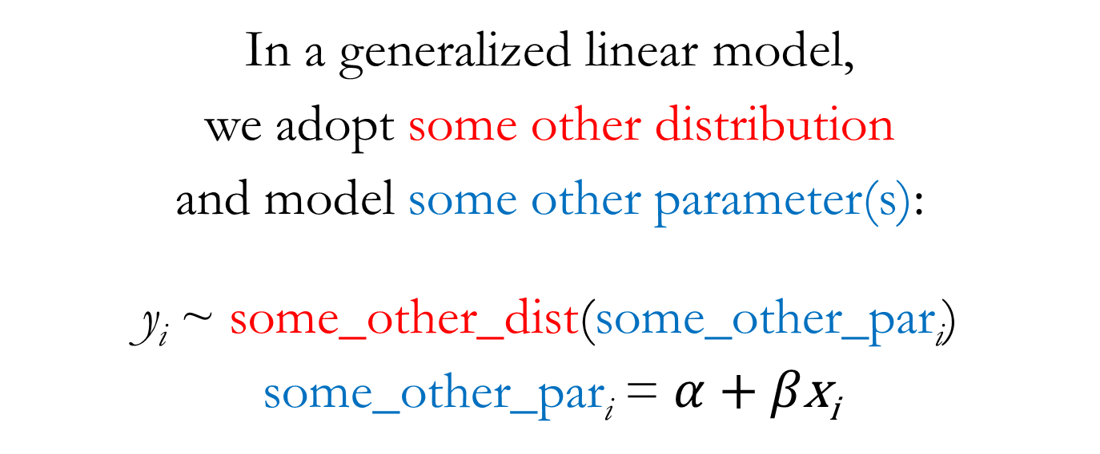
From Linear Models to Generalized Linear Models (GLMs)
In a generalized linear model,
we adopt some other distribution
and model some other parameter(s):
y_{i} ~ some_other_dist(some_other_par$\text{i}$)
some_other_par$\text{i}$ = $α$ + $β\text{x}\text{i}$
Notes:
With a GLM, we’ll use a different outcome distribution
And different outcome distributions will imply different parameters that we can use as the target of the modeling strategies we’ve learned so far

Slide 8
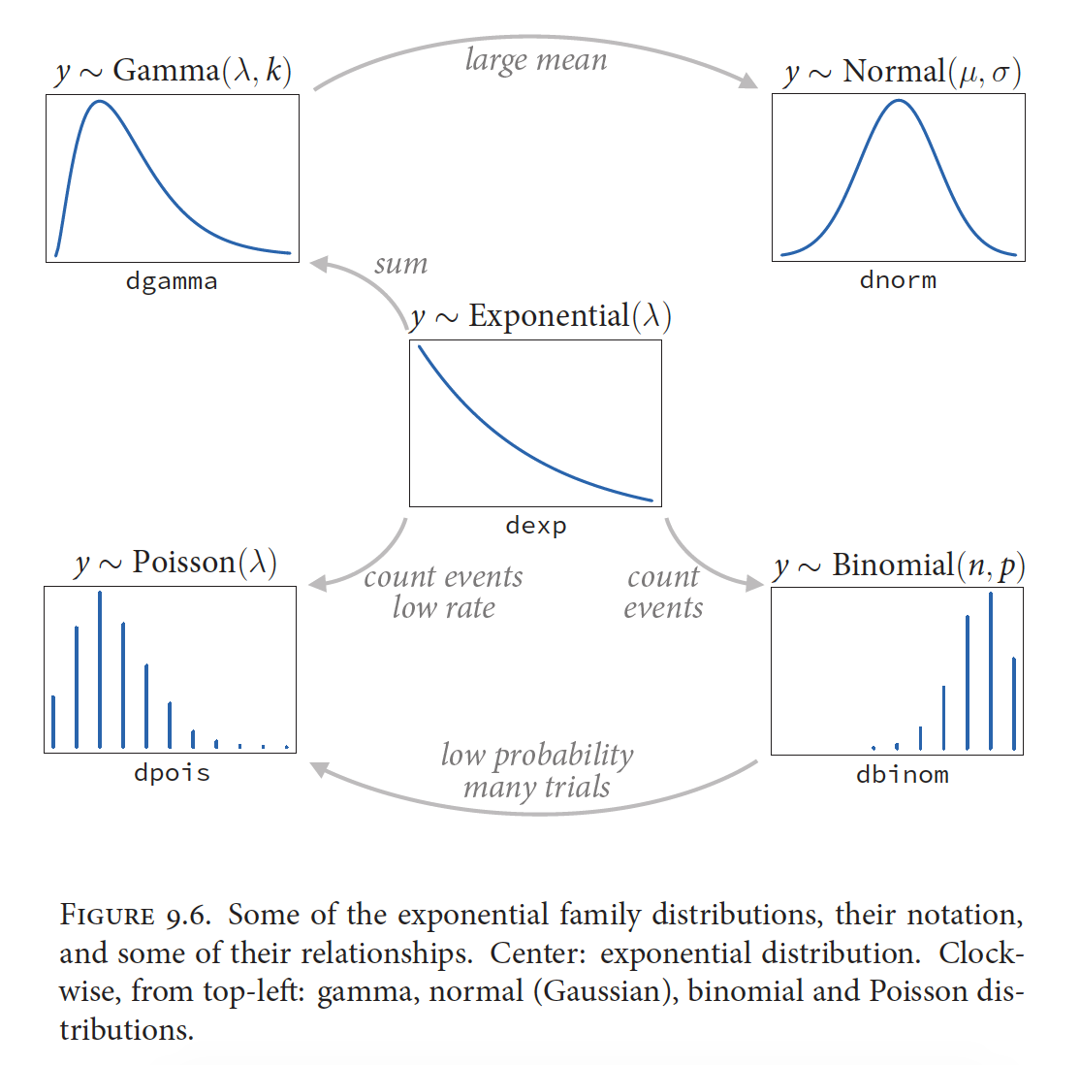
McElreath 2016, Statistical Rethinking

Slide 9
Like exponential distribution but peaks >0 for events that require prior events to occur first
For events that occur at a constant rate in time or space. Useful for survival analyses
For count data. Can think of each count as a trial (to find it) and a success (found it).
McElreath 2016, Statistical Rethinking

Slide 10
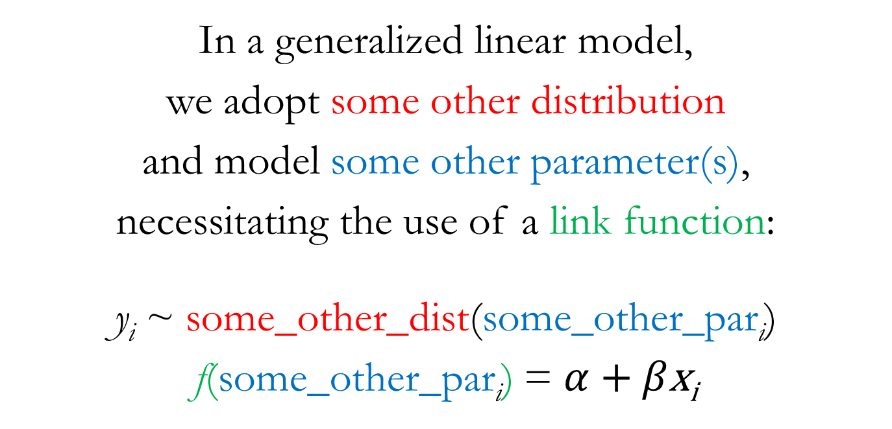
From Linear Models to Generalized Linear Models (GLMs)
In a generalized linear model,
we adopt some other distribution
and model some other parameter(s),
necessitating the use of a link function:
y_{i} ~ some_other_dist(some_other_par$\text{i}$)
f(some_other_par$\text{i}$) = $α$ + $β\text{x}\text{i}$
Notes:
Additionally, modeling of these new parameters will usually necessitate the use of a link function
This is because the new parameters we’ll be interested in modeling are typically not unbounded in both directions
Conveniently, the target of most of our modeling effort so far, the mean parameter in a Gaussian distribution, has been unbounded in both directions, making it easier for us up until this point

Slide 11
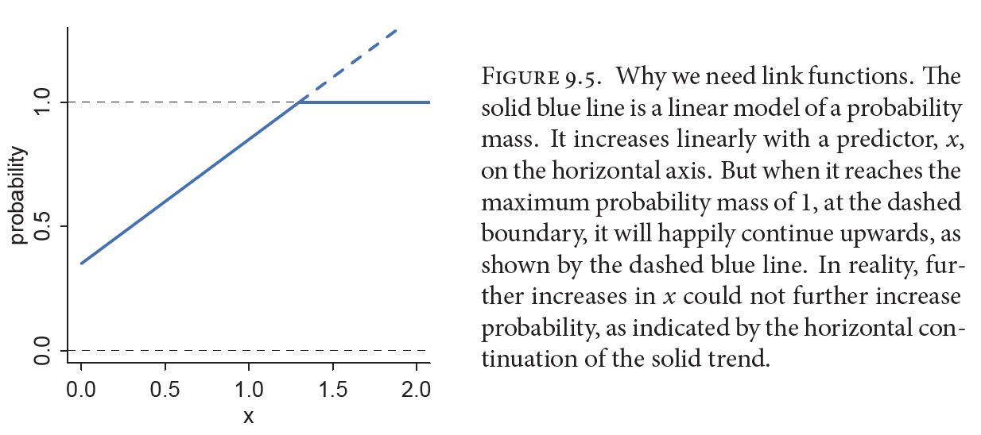
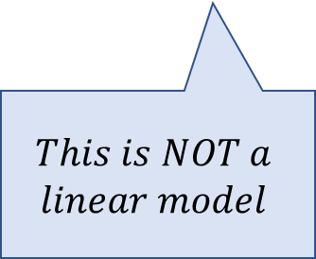
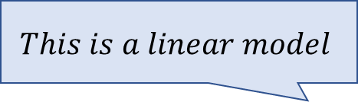
The Necessity of Link Functions
$$This is a linear model$$
$$This is NOT a$$
$$linear model$$
McElreath 2016, Statistical Rethinking

Slide 12
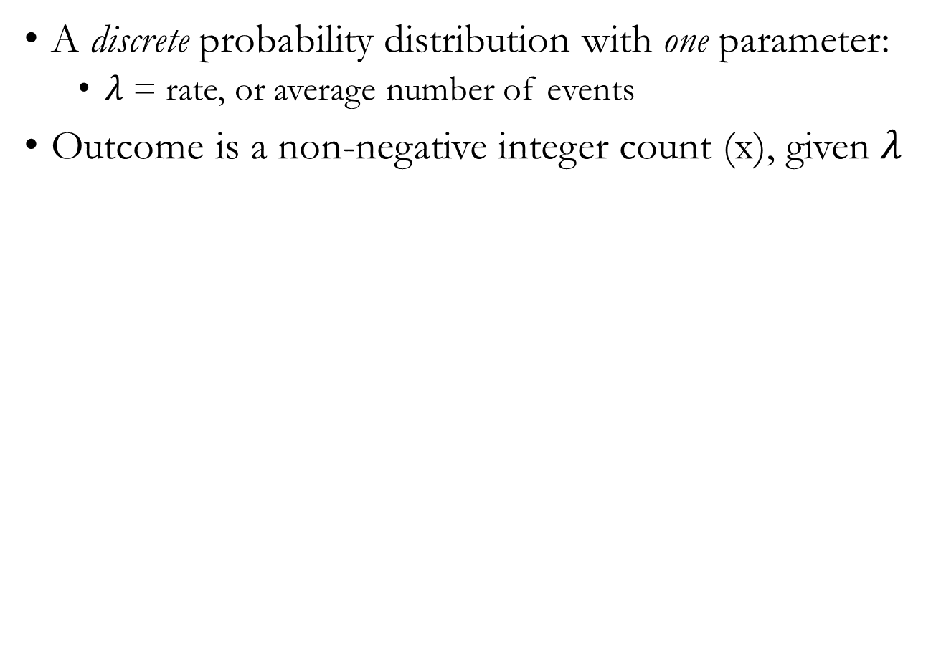
Poisson Distribution
A discrete probability distribution with one parameter:
$λ$ = rate, or average number of events
Outcome is a non-negative integer count (x), given $λ$
Notes:
These are the probability mass functions for three different Poisson distributions
Show lecture code on the Poisson distribution
https://en.wikipedia.org/wiki/Binomial_distribution#/media/File:Binomial_distribution_pmf.svg

Slide 13
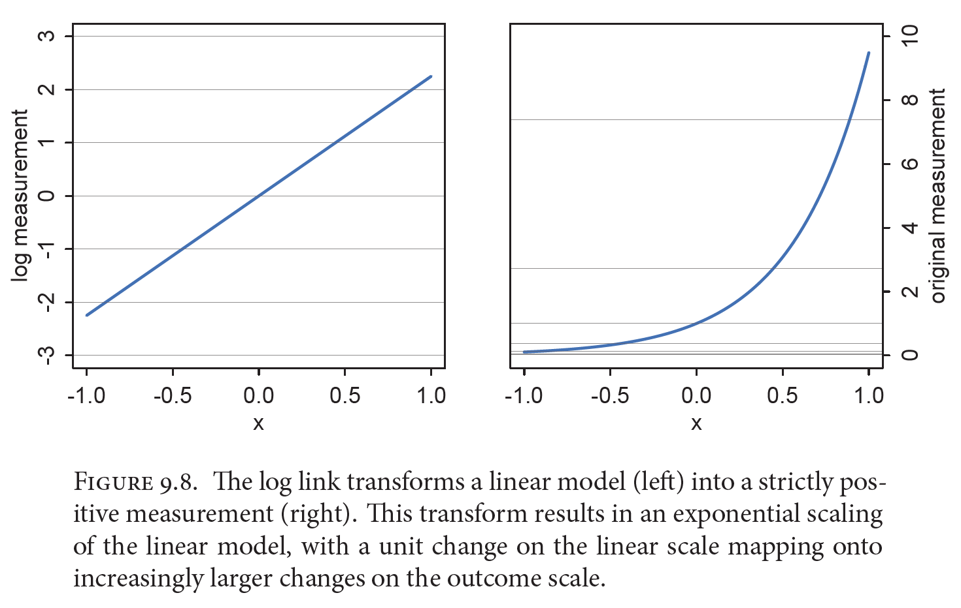
Log Link for Poisson GLMs
Positive values only
Any values possible
We can NOT model this with a linear function that would allow negative values
The log transforms original measurement so that can be modeled with a linear model
Notes:
Log link. This link function maps a parameter that is defined over only positive real values onto a linear model.”

Slide 14
IMPORTANT NOTE
The use of link functions means that the impact of a parameter estimate on the outcome can’t be easily ascertained through inspection of the parameter value because the effect on the outcome measurement depends on where in the parameter space you are.
Thus, plotting predictions becomes crucially important when using link functions.

Slide 15
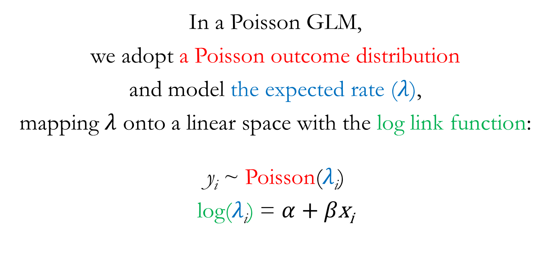
Poisson GLM
In a Poisson GLM,
we adopt a Poisson outcome distribution
and model the expected rate ($λ$),
mapping $λ$ onto a linear space with the log link function:
y_{i} ~ Poisson($λ\text{i}$)
log($λ\text{i}$) = $α$ + $β\text{x}\text{i}$

Slide 16
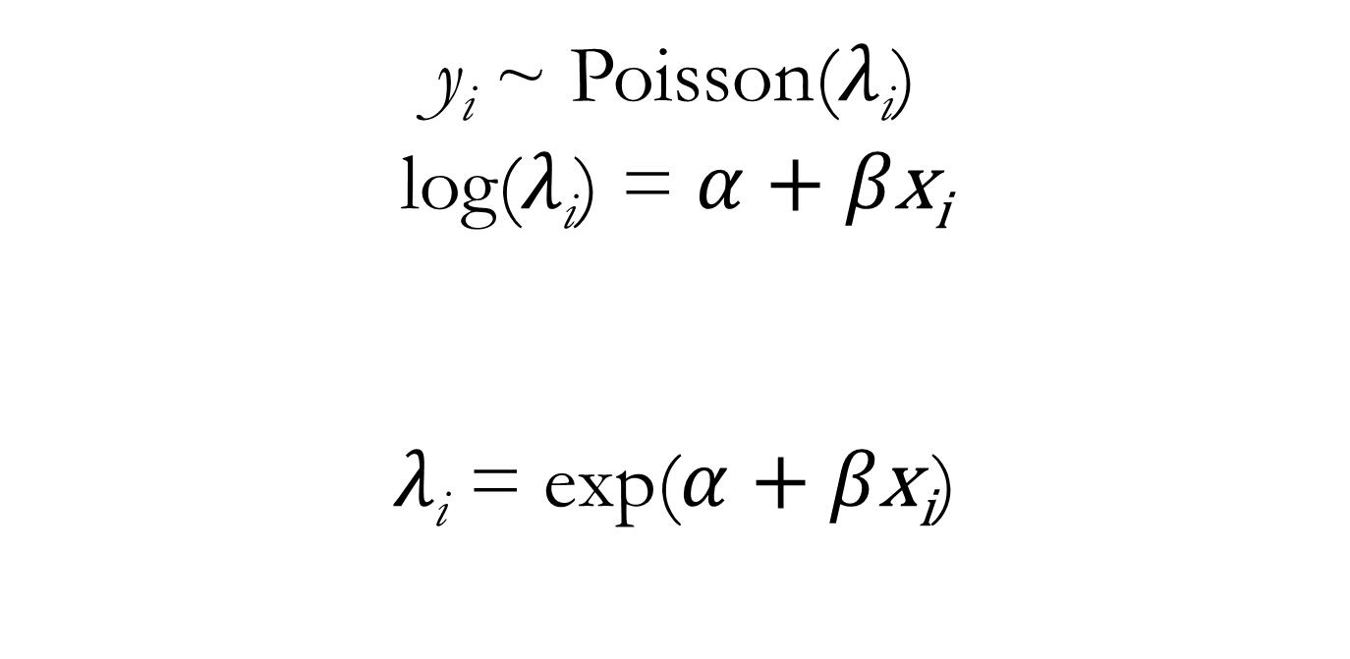
Poisson GLM
y_{i} ~ Poisson($λ\text{i}$)
log($λ\text{i}$) = $α$ + $β\text{x}\text{i}$
$λ\text{i}$ = exp($α$ + $β\text{x}\text{i}$)
The linear portion of our model is used to model the log-transformed parameter value (which puts it on the unbounded scale)
the raw parameter value is defined by applying the inverse link function (the exponential) to the linear portion of the model (forcing the linear portion of the model to take on real, positive values)

Slide 17
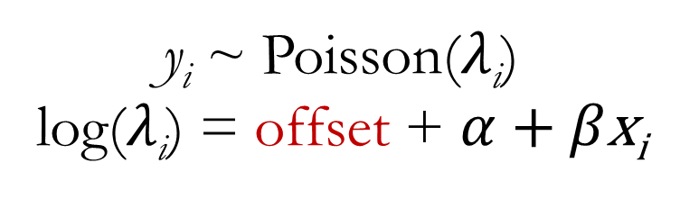
Offset
If “exposure” varies across cases in your data, include the log transformed exposure as an additional parameter in your model to scale the expected number of cases
Example: Your data points are counts of birds at different study sites. Each site has a different number of total visits, which affects the probability of observing a given species
Offset = log (number of visitations)
The offset DOES NOT get a prior!
y_{i} ~ Poisson($λ\text{i}$)
log($λ\text{i}$) = offset + $α$ + $β\text{x}\text{i}$

Slide 18
Example dataset (chapter 11)
Tool development by historic Oceanic societies
Hypotheses:
Number of tools increase with log population size
Number of tools increases with the contact rate among islands
The impact of population size on tool number depends on contact rate to other islands (positive interaction)

Slide 19
Lecture code, part 2

Slide 20

Binomial models
For binomial outcomes

Slide 21
Binomial Distribution
A discrete probability distribution with two parameters:
n = number of trials,
p = probability of success
Outcome is the number of successes (x) in n trials, given a probability of success p
This is what our model is trying to estimate!
Notes:
Note the confusion that might arise with the “probability of success” parameter here in the binomial distribution
This is a parameter we’re trying to estimate
So, a posterior distribution for the probability of success parameter (p) shows us the relative probability of different probability of success values
These are the probability mass functions for three different binomial distributions
https://en.wikipedia.org/wiki/Binomial_distribution#/media/File:Binomial_distribution_pmf.svg

Slide 22
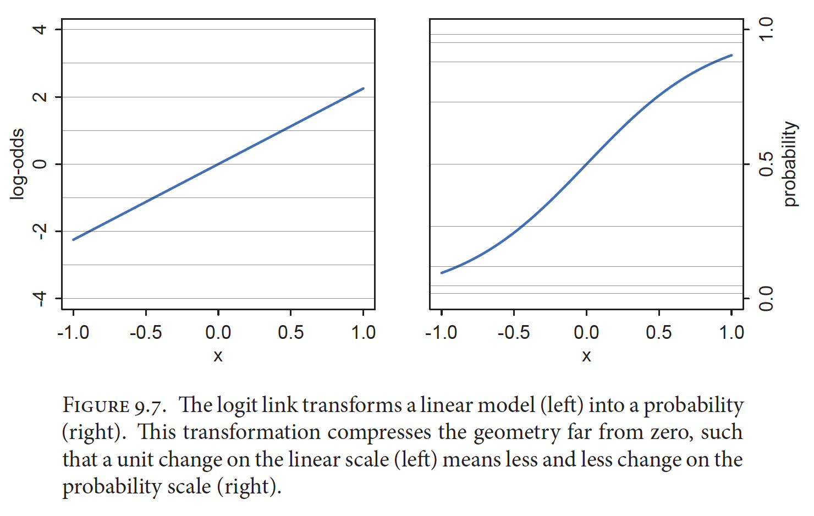
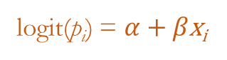
Logit Link for Binomial GLMs
The logit link maps a parameter that is defined as a probability mass, and therefore constrained to lie between zero and one, onto a linear model that can take on any real value.
logit(p_{i}) = $α$ + $β\text{x}\text{i}$

Slide 23
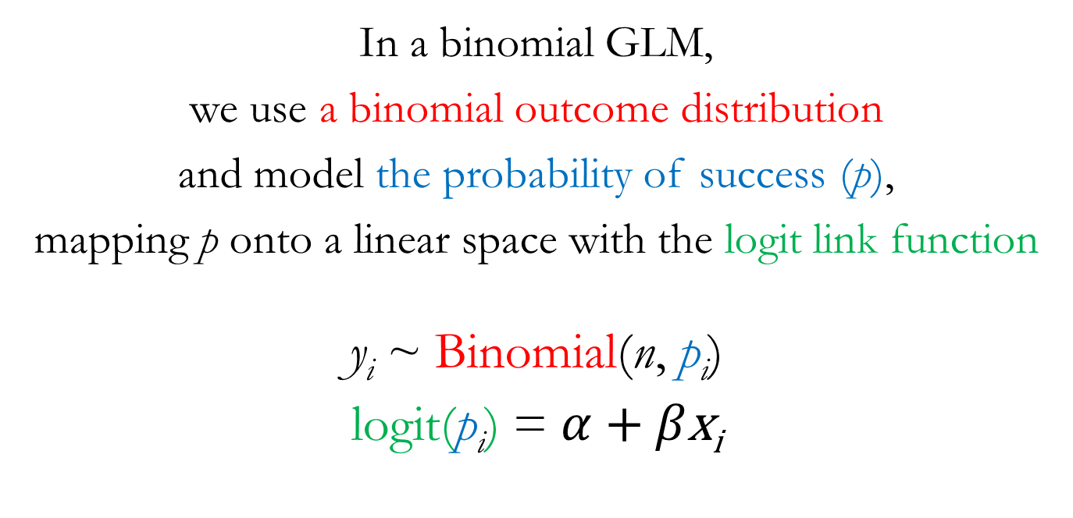
Binomial GLM
In a binomial GLM,
we use a binomial outcome distribution
and model the probability of success (p),
mapping p onto a linear space with the logit link function
y_{i} ~ Binomial(n, p_{i})
logit(p_{i}) = $α$ + $β\text{x}\text{i}$

Slide 24
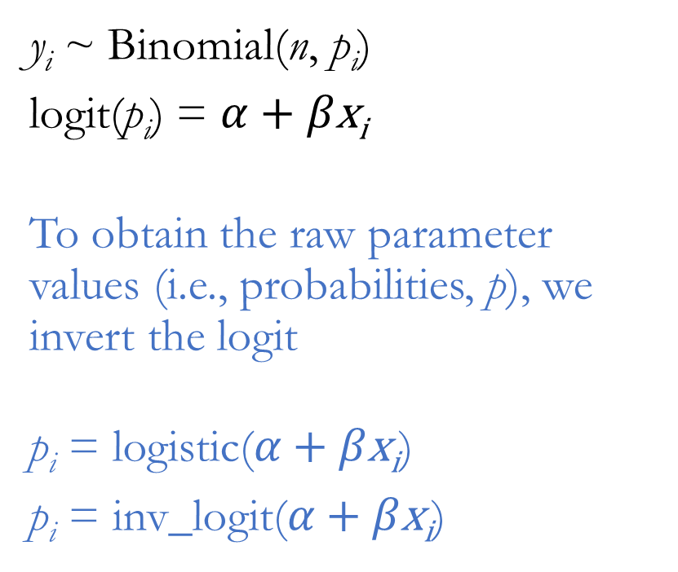
Binomial GLM
y_{i} ~ Binomial(n, p_{i})
logit(p_{i}) = $α$ + $β\text{x}\text{i}$
To obtain the raw parameter values (i.e., probabilities, p), we invert the logit
$\text{p}\text{i}\text{ =} \text{logi}\text{s}\text{t}\text{ic}\text{(}α\text{ + }β\text{x}\text{i}$)
$\text{p}\text{i}\text{ = }\text{inv}\text{_}\text{logit}\text{(}α\text{ + }β\text{x}\text{i}$)
IMPORTANT
Because of the link function, the coefficient estimates in your model output are the logit of the estimated probability. To obtain actual probabilities, or changes in probabilities, you must take the inverse of the value, using inv_logit() function.

Slide 25
Probabilities vs. log-odds vs. odds
The logit function is defined as
logit ( p ) = log ( p / ( 1 – p ) )
The inverse of the log function is exponentiation:
Odds = exp ( logit ( p ) )
The change in predicted odds with a change in your predictor variable, then, is simply:
Odds ratio = exp ( slope coefficient )
This is also called the log-odds
p / (1-p) is the probability of an event happening divided by the probability of it not happening (odds)

Slide 26
Two Flavors of Binomial GLM
Logistic regression commonly refers to the situation when binomial data are organized into single-trial cases
The number of trials (n) for every observation will simply be 1
The number of successes (y) can only be 0 or 1
Aggregated binomial regression refers to the situation when binomial data are aggregated for all observations having the same covariate values
The number of trials (n) for every “observation” may differ
The number of successes (y) can range from 0 to n

Slide 27
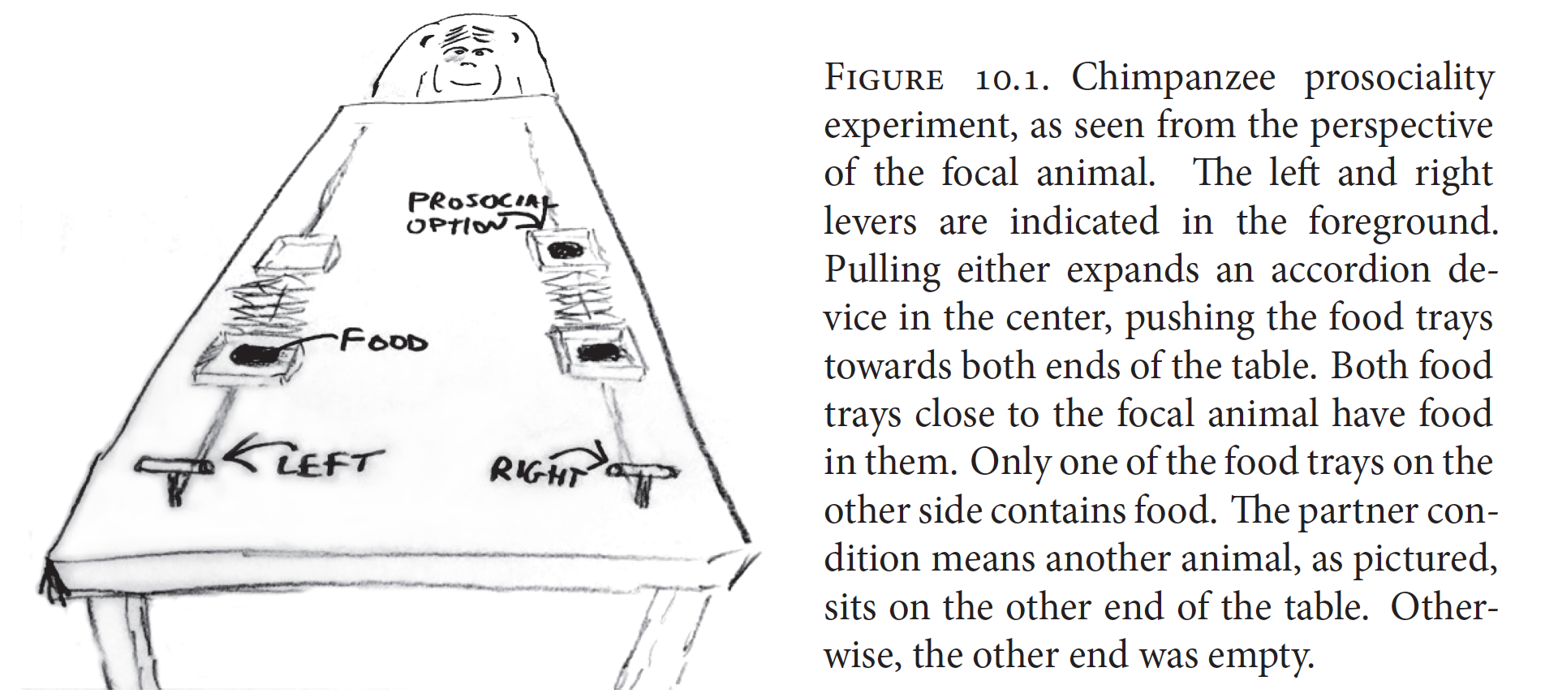
Logistic Regression Example Prosocial Chimpanzees
McElreath 2016, Statistical Rethinking
Notes:
Two experimental variables of interest: the side of the table on which the prosocial option appeared and partner vs. control condition

Slide 28
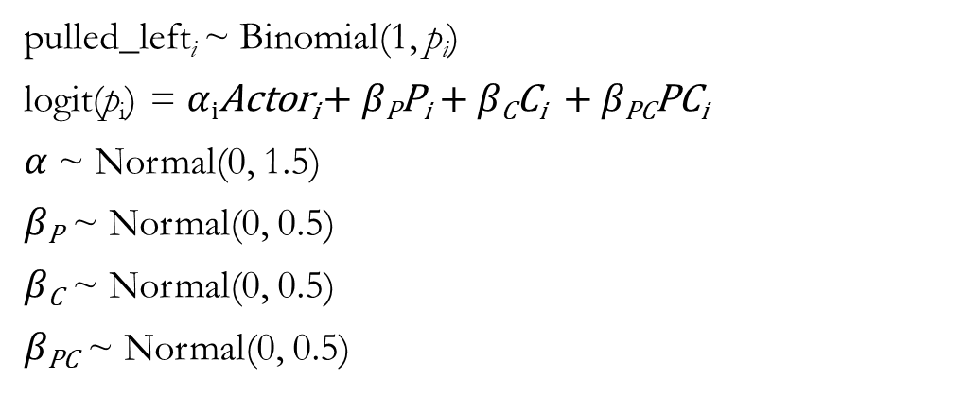
Binomial GLM for Chimpanzee Prosociality
Outcome:
Pulled left side (yes/no)
Predictors:
Actor (individual chimpanzee)
Prosocial on left side (yes/no)
Condition (partner present or absent)
pulled_left_{i} ~ Binomial(1, $\text{p}\text{i}$)
logit(p_{i}) = $α$_{i}Actor_{i} + $β\text{P}\text{P}\text{i}$ + $β\text{C}\text{C}\text{i}$ + $β\text{PC}\text{PC}\text{i}$
$α$ ~ Normal(0, 1.5)
$β\text{P}$ ~ Normal(0, 0.5)
$β\text{C}$ ~ Normal(0, 0.5)
$β\text{PC}$ ~ Normal(0, 0.5)
Notes:
Show lecture code of chimpanzee models

Slide 29
Aggregated Binomial Regression Example Many Shades of Snow Geese
White Morph
Blue Morph
Notes:
Show lecture code of snow goose models
https://www.allaboutbirds.org/guide/Snow_Goose/media-browser/59939451
https://www.allaboutbirds.org/guide/Snow_Goose/media-browser/78204831

Slide 30
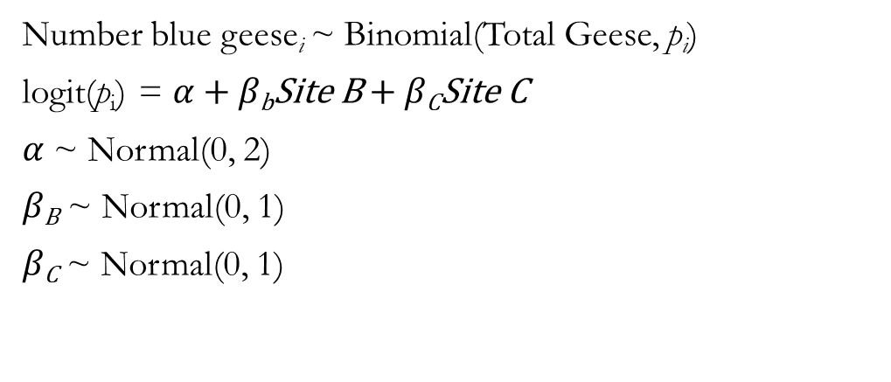
Binomial GLM for Snow Geese Example
Outcome:
Number of geese observed
Predictors:
Site
Number blue geese_{i} ~ Binomial(Total Geese, $\text{p}\text{i}$)
logit(p_{i}) = $α$+ $β\text{b}\text{Site} \text{B}$ + $β\text{C}\text{Site} \text{C}$
$α$ ~ Normal(0, 2)
$β\text{B}$ ~ Normal(0, 1)
$β\text{C}$ ~ Normal(0, 1)

